Slide 1

Leonard Maaya
Candidate for the Biostatistician position at
BIOCARTIS

Slide 2
Objective
To determine the limit of detection of the Idylla™ SARS-CoV-2 using a sample dilution series of positive clinical samples collected at a range of input levels (copies/ml) each with 24 cartridges.
Data issues/QC
Unnamed first column has no #72
Remarked rows (Between B and C Small spot; error repeat run)
How should these be handled; needs discussion to or not to include in the analyses
For this analysis, they are part of the results
Analysis excluding the two remarked rows available at the end of the slides

Slide 3
Cartridge detection (Positive call) rates vs input level
Input Level (copies/ml) | N | Detected (%)
125 | 24 | 18(0.75)
250 | 24 | 22(0.92)
500 | 24 | 24(1.00)
750 | 24 | 24(1.00)
1000 | 24 | 24(1.00)
2000 | 24 | 24(1.00)
4000 | 24 | 24(1.00)

Slide 4
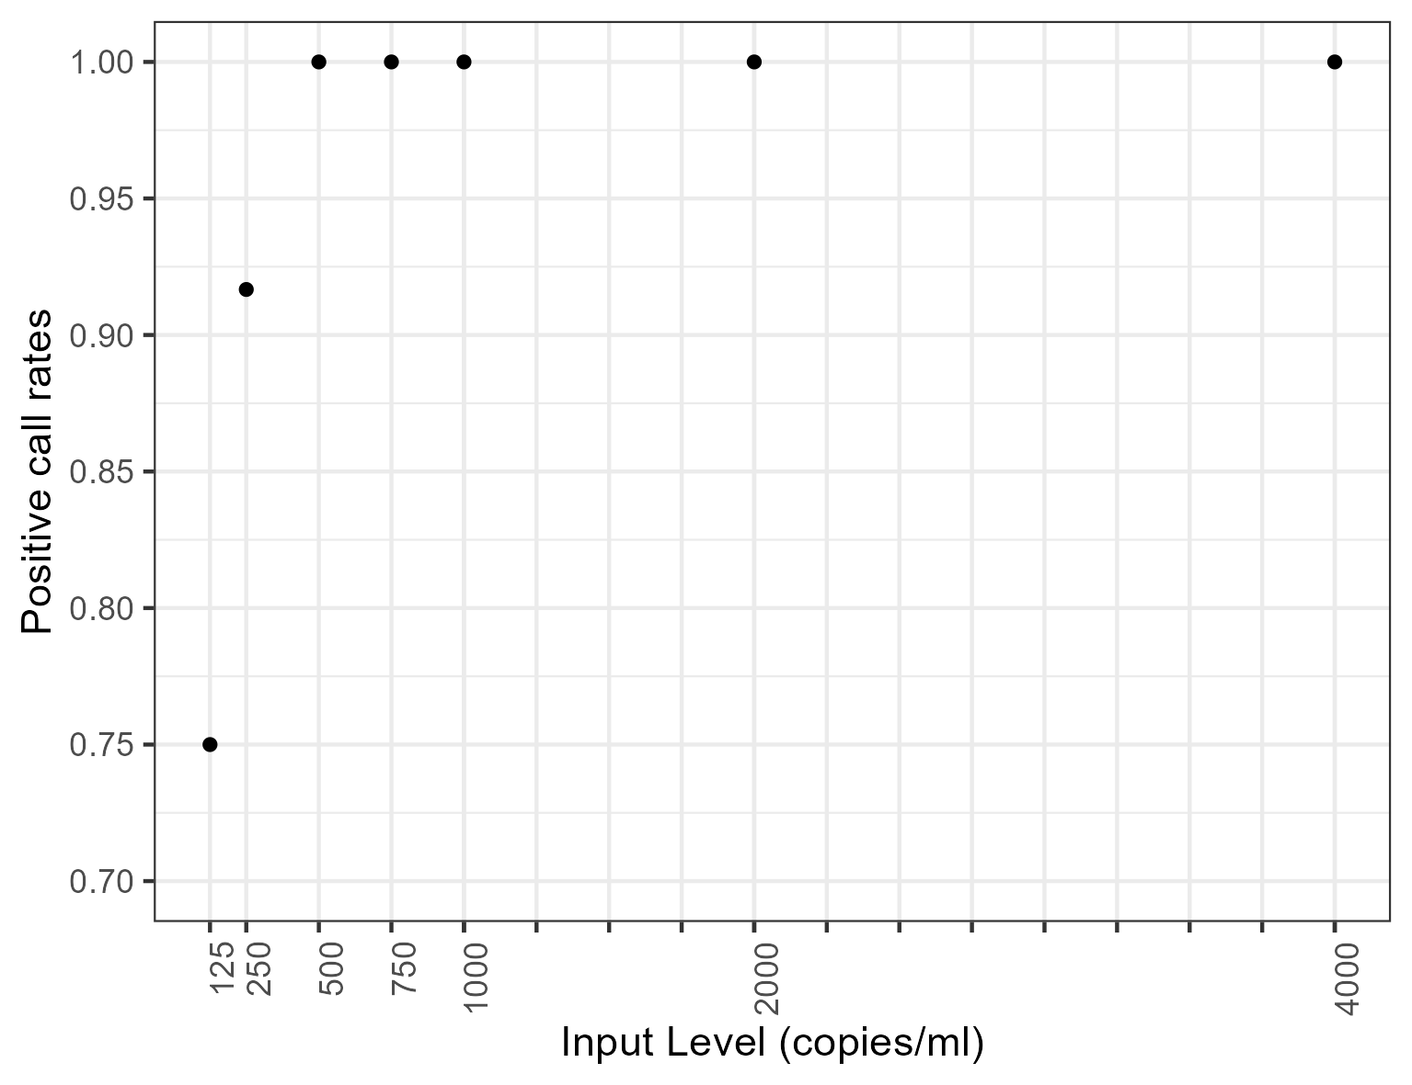
Positive call rates vs input levels

Slide 5
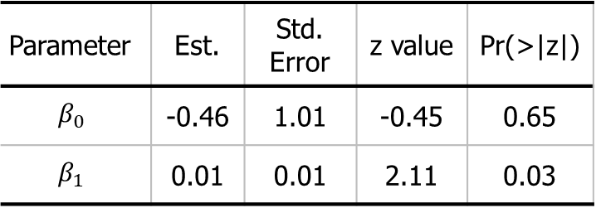

Statistical model
Model: Logistic regression
$\text{logit}\text{(}p\text{)}=β_{0}+β_{1}\text{∗}\text{input} \text{level}$
To find the lowest input level; find predicted positive rates from the model for a grid of values [125, 4000]
Lowest input level (cps/ml) with 95% positive call rates:
282
Corresponding 95% Wilson CI for the input level (cps/ml):
c(146, 418)
Parameter | Est. | Std. Error | z value | Pr(>|z|)
$$β_{0}$$ | -0.46 | 1.01 | -0.45 | 0.65
$$β_{1}$$ | 0.01 | 0.01 | 2.11 | 0.03

Slide 6
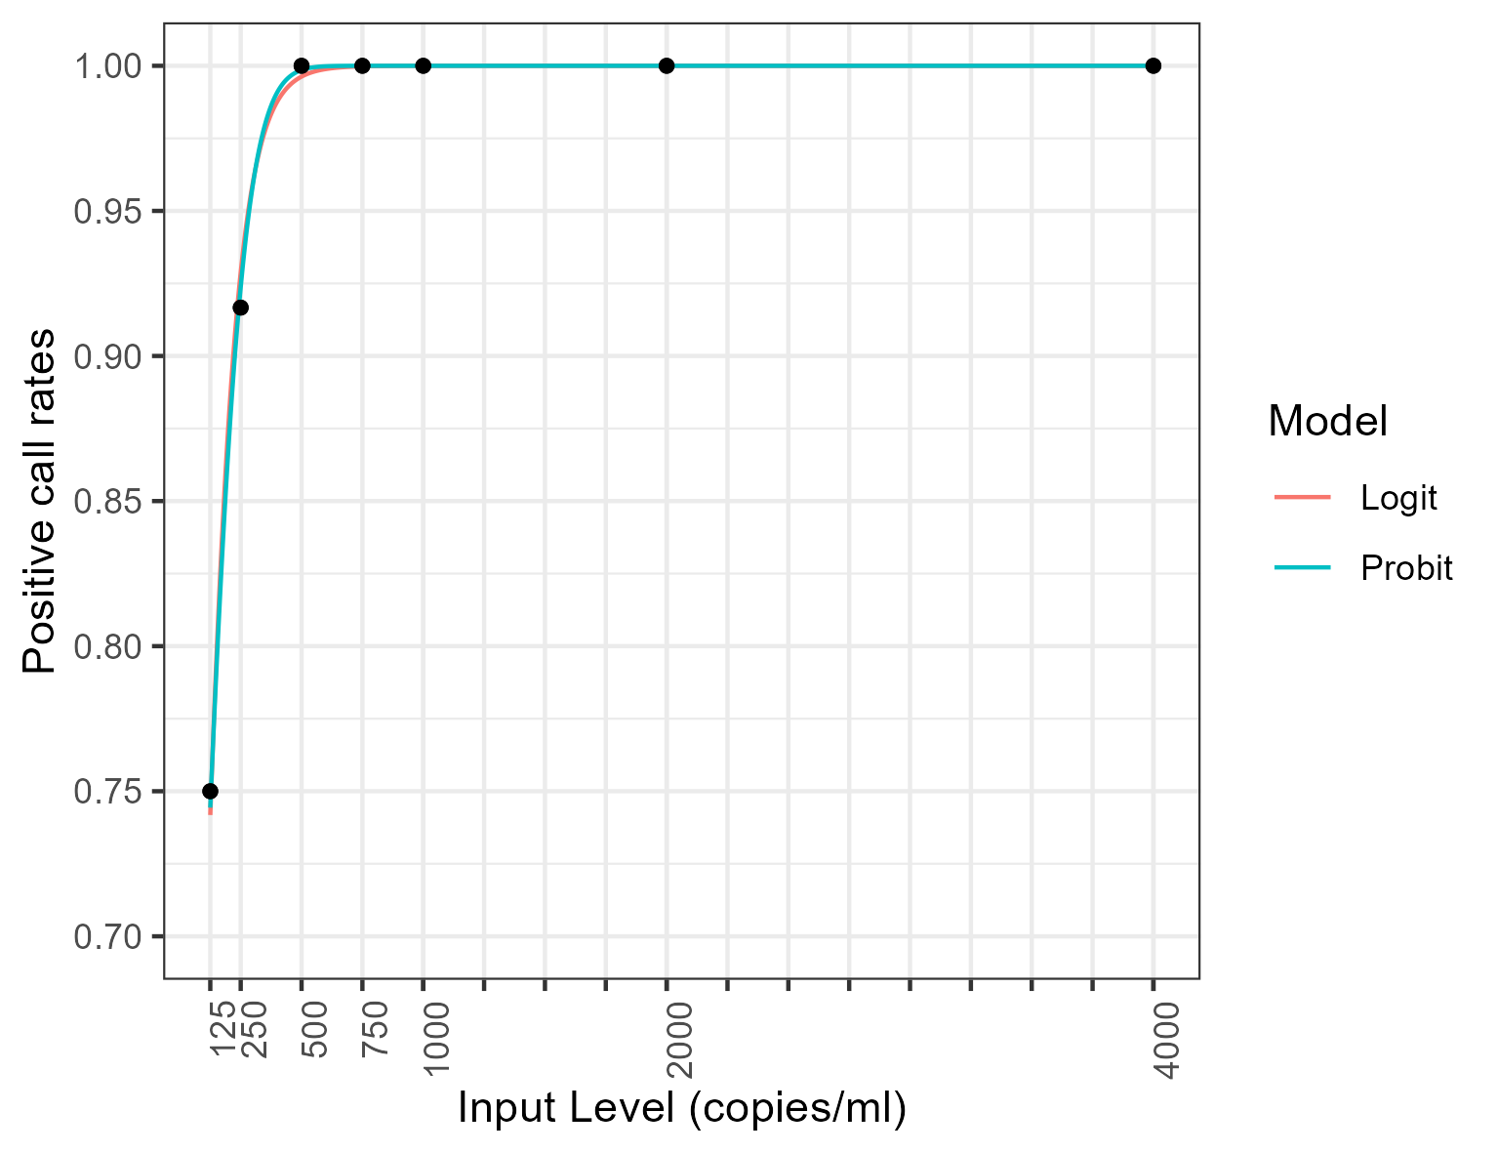
Possible consideration: Probit model

Slide 7
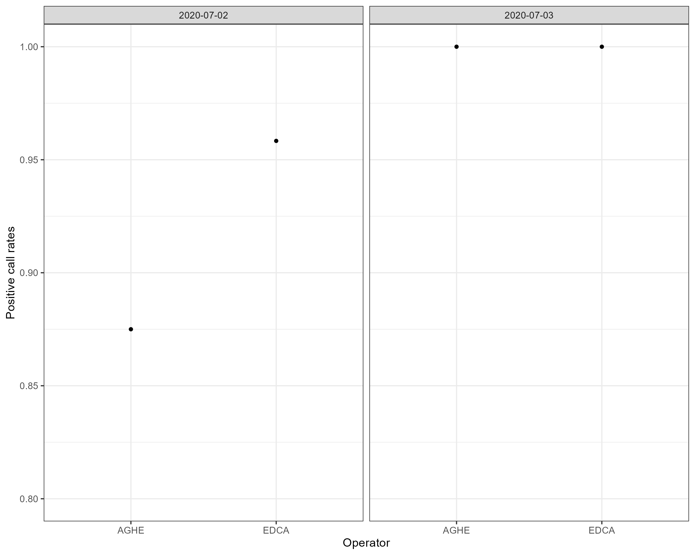
To be checked: Operator - Date vs Positive call rates

Slide 8
Modeling
Include more variables in the analysis?
Bayesian?
Prior information may help avoid including input values beyond 500 cps/ml when determining LoD
DoE?
To determine the optimal number of cartridges for a similar exercise in the future?
To determine the factors and optimal ranges for the factors for a similar exercise in the future
Simulation study?
Automate analysis ?

Slide 9
Thank you for your time and attention.

Slide 10
To be checked
Operator vs Positive call rates
Day vs Positive call rates
Day-Operator vs Positive call rates interaction

Slide 11
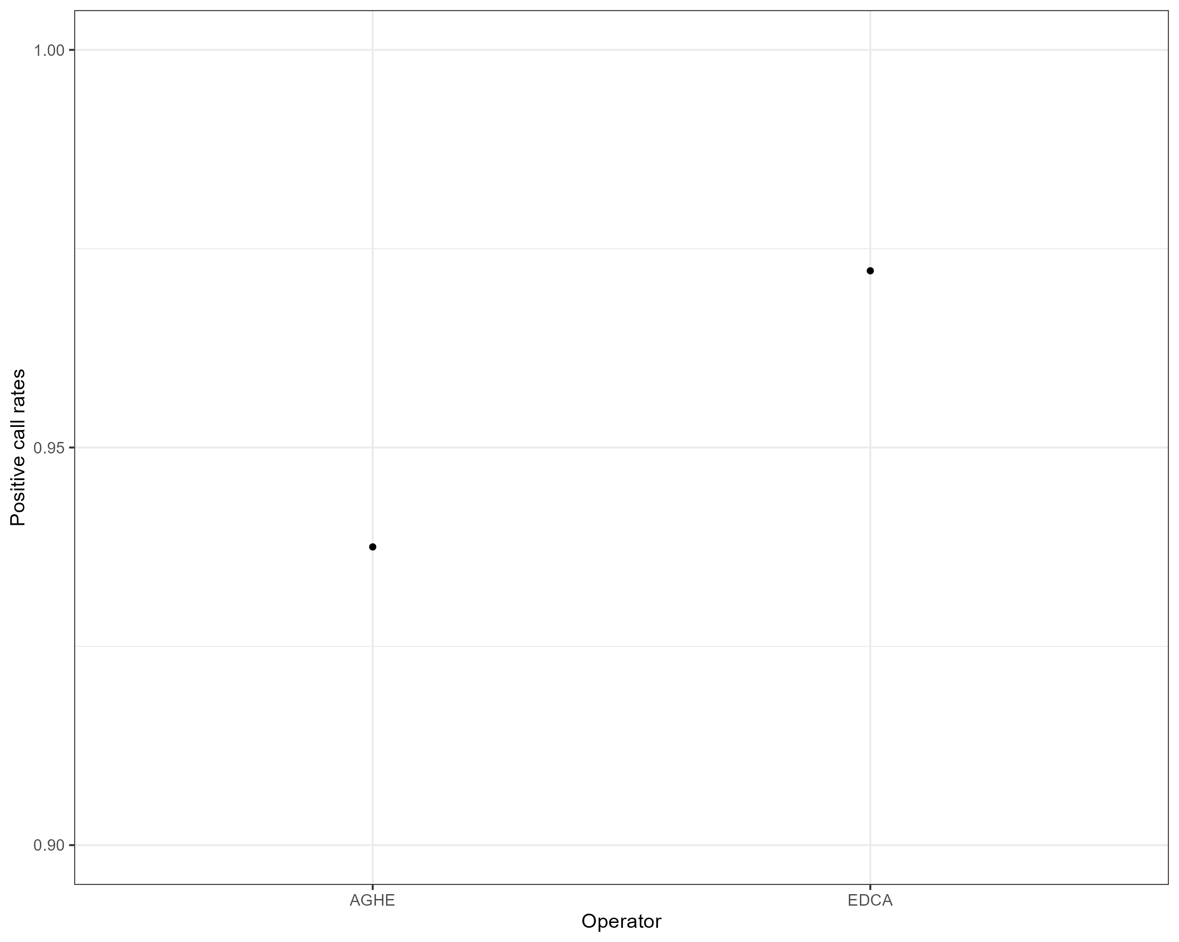
Operator vs Positive call rates

Slide 12
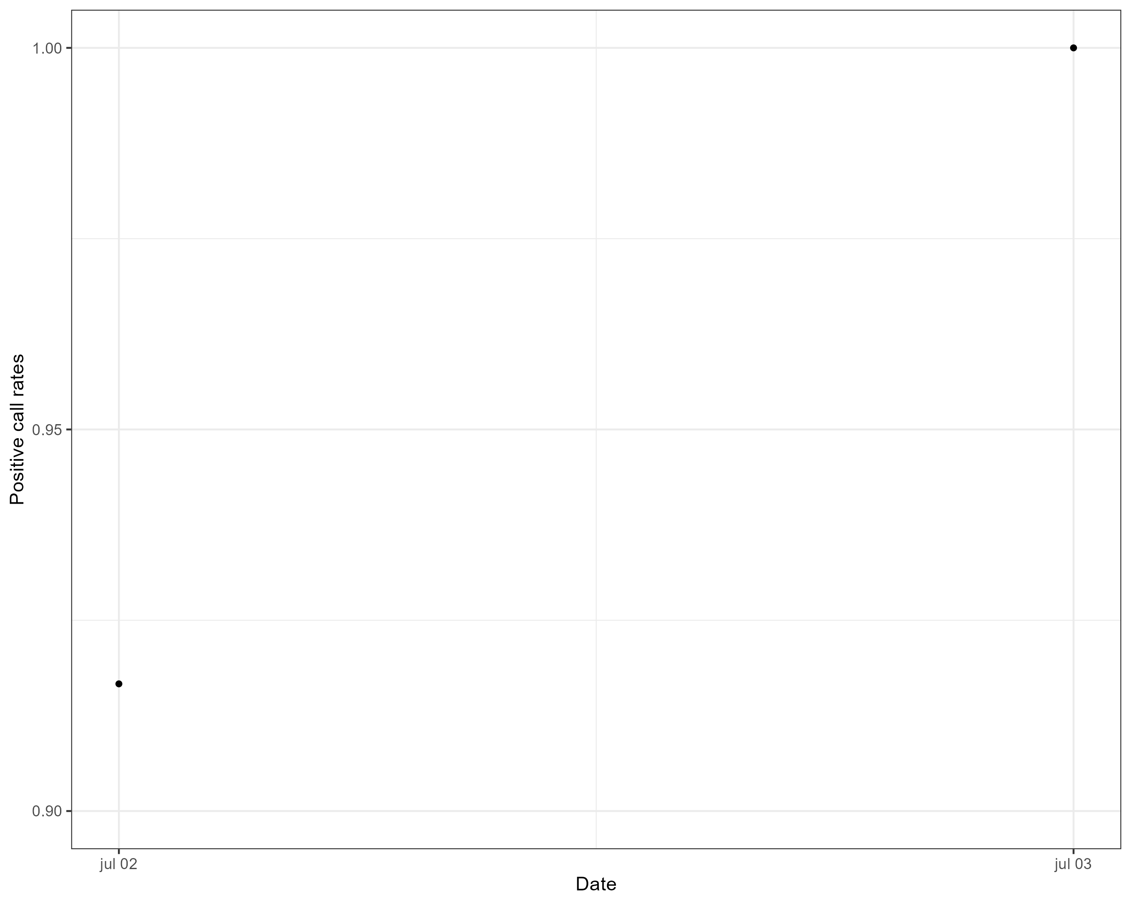
Date vs Positive call rates

Slide 13
Cartridge detection (Positive call) rates vs input level
Input Level (copies/ml) | N | Detected (%)
125 | 24 | 18(0.75)
250 | 23 | 21(0.91)
500 | 23 | 23(1.00)
750 | 24 | 24(1.00)
1000 | 24 | 24(1.00)
2000 | 24 | 24(1.00)
4000 | 24 | 24(1.00)

Slide 14

Positive call rates vs input levels

Slide 15
Statistical model
Model: Binomial
Fixed effects
Lowest input level (cps/ml) with 95% positive call rates:
285
Corresponding 95% Wilson CI for the input level (cps/ml):
c(147, 423)

